Slide 1
NeSNis Network Sniffing Analysis
D.N. Vasisht (IIIT-D)
Mayank Mohindra (IIIT-D)
Viraj Parimi (IIIT-D)

Slide 2
What is NeSNis ?
Tool to monitor internet usage
Sniff Packets from the users
Filter and Analyze
Provide administrator to make appropriate changes

Slide 3
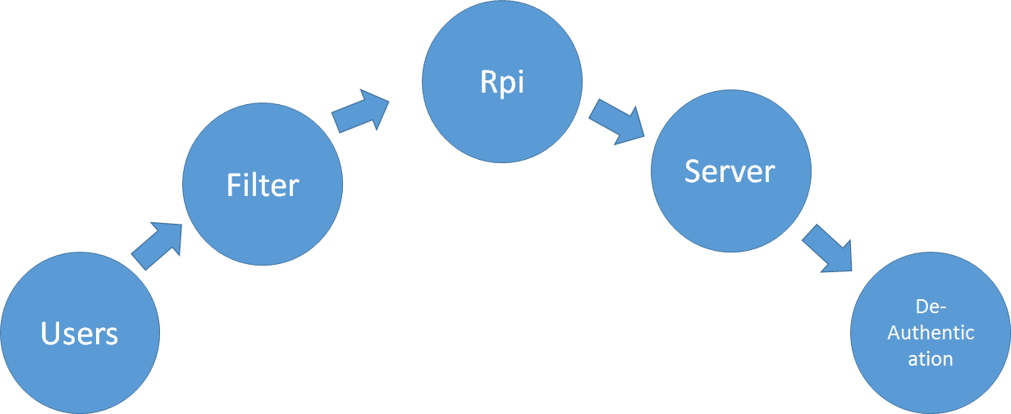
Flowchart

Slide 4
Implementation
Tshark to sniff packets (get source and destination mac address) after time interval
Find IP of Destination Server
Resolve IP to get hostname(DNS lookup,whois)
Shell script to filter data
SSH to move data to Web Server
Shell Scripts to get Ip and Mac addresses(arp-scan)
Aircrack-ng suite(aireplay) to deathenticate the user(deauth packets)
Web designing in Django, Javascript, HighCharts, CSS.

Slide 5
Limitations
Does not Work in Intranet (All data through gateway device 224.0.0.*)
Cannot detect VPN and Proxy
Rpi2 cannot work in this scenario(arp-cache)
Analysis is limited to a few fields at the moment

Slide 6
Applications
Monitoring Internet usage in classrooms
Can be used in Corporate environments
Parental Guidance at home

